Slide 1
Farmers Market
By the Express-Yourself Team

Slide 2
Overall concept
Design and build a website for an organic farmers market.
This website has organic grocery products for sale.
The user logs in to the website and isthen able to put products in their shopping cart, checkout (purchase) and arrange delivery of their groceries.

Slide 3
Motivation
To use a number of features to make an integrated shopping platform.
To create an attractive and simple to navigate and interact with shopping site.
The codebase for this platform could be used to develop similar shopping sites.

Slide 4
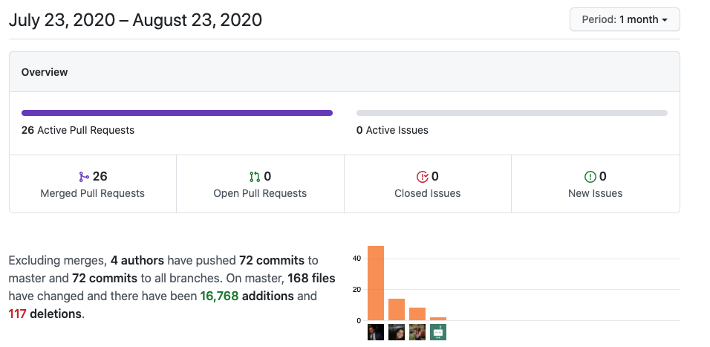
Design Process
Agreed upon project concept as team
Pulled starter code for Project2
Assigned Tasks
Louise Cerdeira
Benson Coelho
Yvette Waller
Agreed on core structure, design, features and concepts.
Collaborated and communicated to build our code!

Slide 5
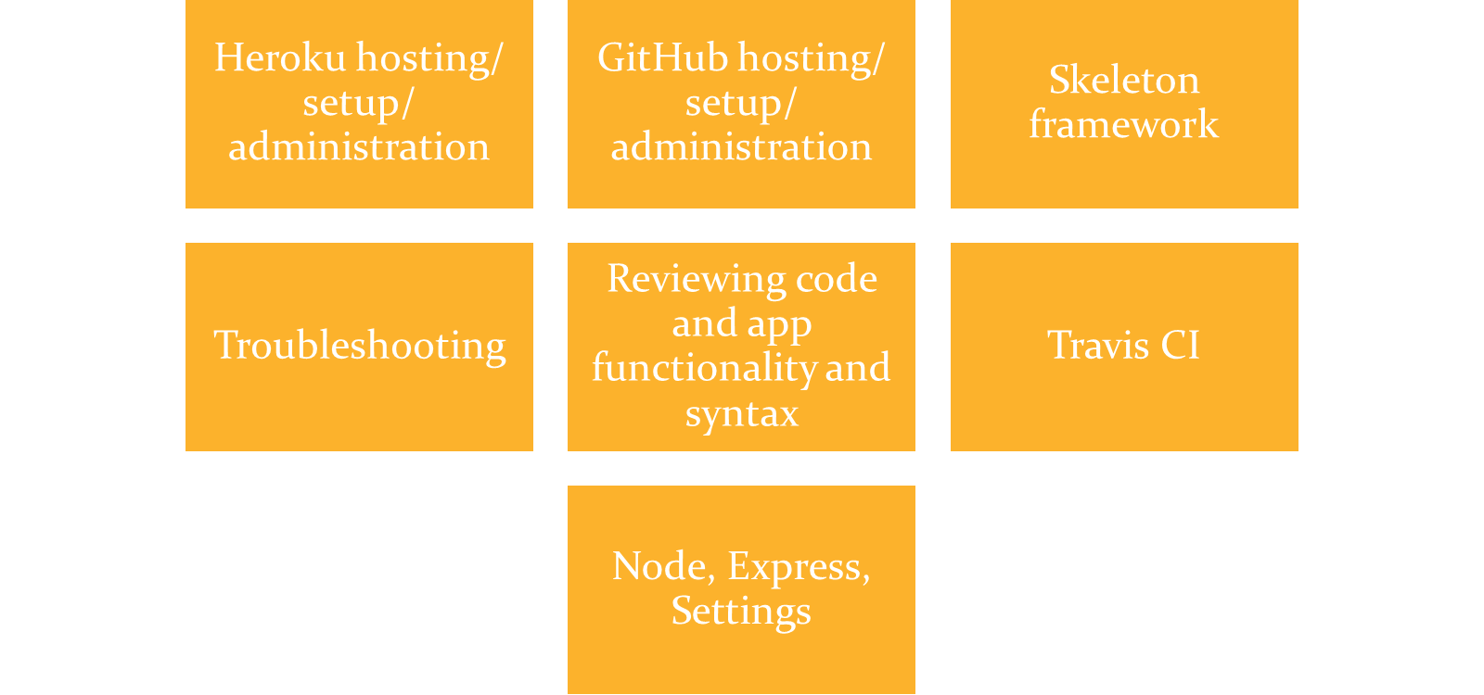
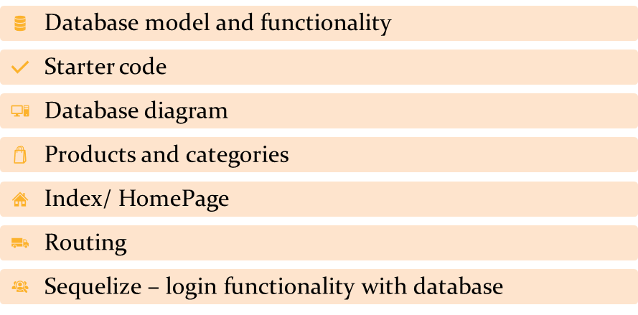
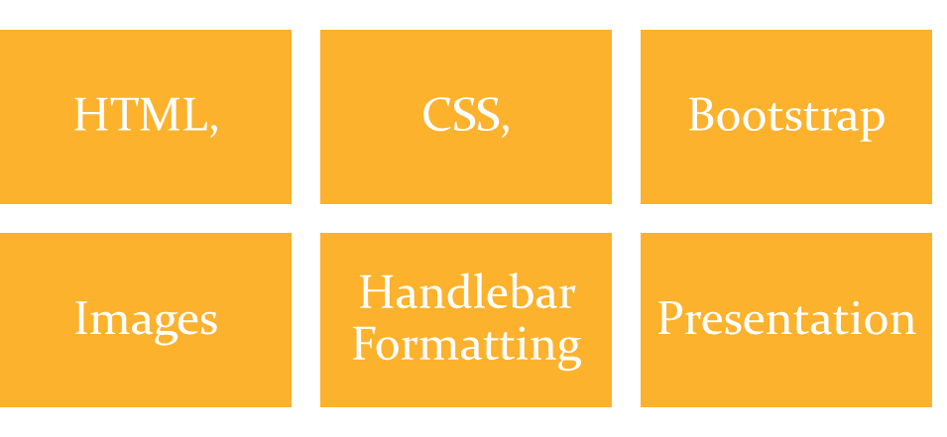
Task assignment
Louise | Benson | Yvette

Slide 6
Technologies used (1)
GitLab
Web based DevOps: codebase and instructions
GitHub
Hosting for software development and version control. Hosting our project files, version control, collaborative updates and review.
VS Code
Source code editing, debugging, syntax
Javascript, HTML
Coding languages

Slide 7
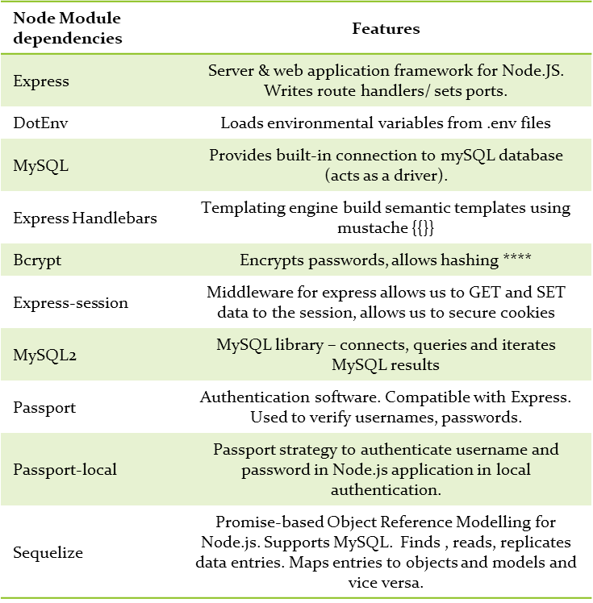
Technologies used (2)
NPM
Javascript programming language, used to run Node Modules (see table)
MySQL
Relational database management. Integrates with website, VS Code and Heroku to store user data.
Heroku
Cloud platform. Hosts our app and modules for demonstration purposes.

Slide 8
Demonstration
Farmers Market Website and Application

Slide 9
Presenter 1: Louise
Heroku hosting/ setup/ administration
GitHub hosting/ setup/ administration
Skeleton framework
Troubleshooting
Reviewing code and app functionality and syntax
Travis CI
Node, Express, Settings

Slide 10
Architecture
Macro
MVC
Client side - React
Server side - Node.js
axios
MySQL
Router
Components
Http
RESTful
API
ORM

Slide 11
Architecture
Server side - Node.js
MVC
DB
Express
RestAPI
Node.js files
Sequelize ORM
POST/GET
MySQL
Users data
Response
TABLE
Users
Users

Slide 12

Architecture
Client side - React
MVC
+
+

Slide 13
Presenter 2: Benson
Database model and functionality
Starter code
Database diagram
Products and categories
Index/ HomePage
Routing
Sequelize – login functionality with database

Slide 14
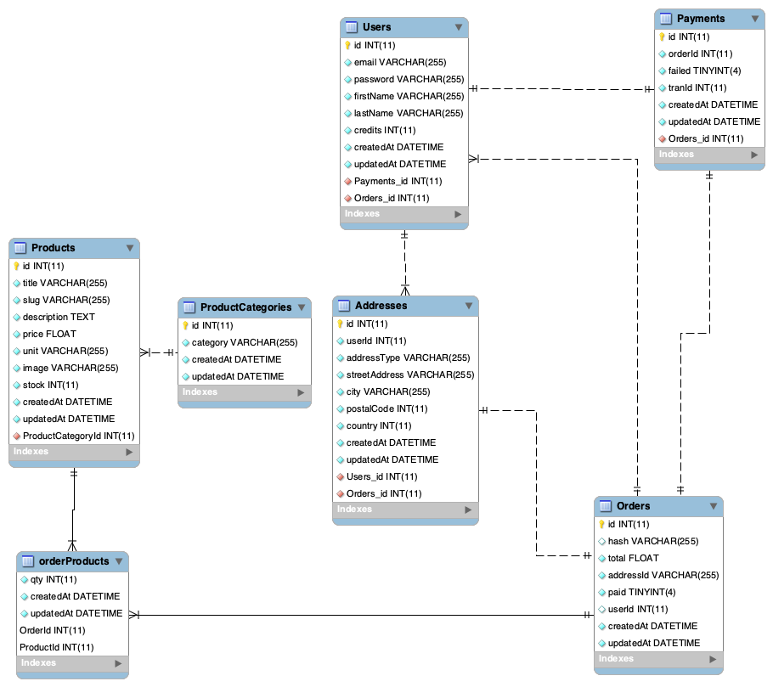
Diagram database
- ER diagram create in MySQL Workbench,
using ‘reverse engineer’
- Deploy using JawsDB MySQL (Heroku)

Slide 15
Presenter 3: Yvette
HTML,
CSS,
Bootstrap
Images
Handlebar Formatting
Presentation

Slide 16
Directions for Future Development
This codebase could be used for a grocery or produce store.
It could also be modified to suit any shopping application
Components of the code can be utilized to support any web application where secure login and data storage is required.
Thank you for viewing our project!

